Slide 1

Open Linked Data for Metabolomics Data Sharing
Leibniz-Institut für Pflanzenbiochemie
Daniel Schober, IPB Halle
for COSMOS WP 2

Slide 2
Outline
Challenges in Data Representation
Introduction ‚Open Linked Data‘
RDF: Resource Description Framework
Subject-Predicate-Object Triples
Cross-resource Querying
Linked Metabolomics Data Resources
IPB Resources
External Resources to Integrate
Example Queries
Conclusions

Slide 3
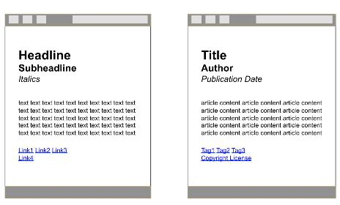
HTML encodes graphical markup Annotation of no use for Search Engines !
Current Web =
Web of HTML Documents
What Computers see
What Humans see
H1,18pt.
H2,16pt. bold
H3, 18pt.

Slide 4
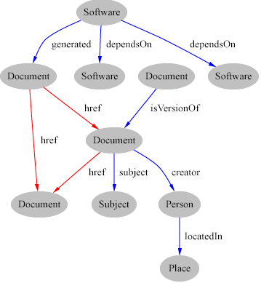
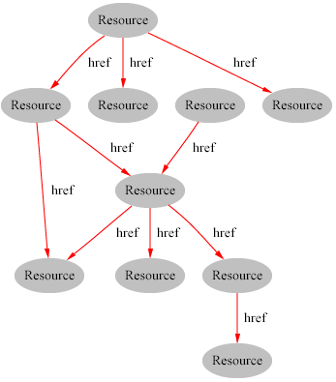
Web (HTML) vs. Semantic Web (RDF)
Web of Docs
Semantic Web Knowledge Graph
Content awareness
e.g. makes the author explicit & searchable

Slide 5
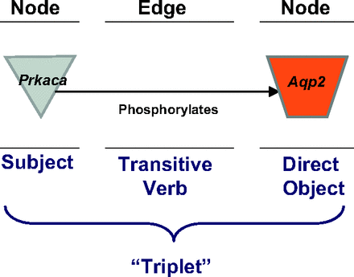
Subject-Predicate-Object Knowledge Assertions in RDF
Connected into Graph:
Providing contextual Interpretation
a knowledge atom

Slide 6
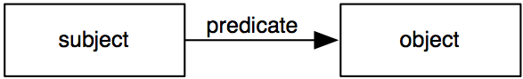
RDF Triples come in different forms
Graphical form
Triple | subject predicate object
Relational form | predicate(subject,object)
RDF/XML | <rdf:Description rdf:about="subject"> <ex:predicate> <rdf:Description rdf:about="object"/> </ex:predicate> </rdf:Description>
Turtle | subject ex:predicate object.

Slide 7
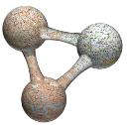
RDF Triple store = Way we think!
Sets of Triples
Subject Property Object
<Steffen Neumann> has-role <Group Leader>
<Group Leader> manages <Group Pages>
< Steffen Neumann > works-in <IPB-Halle>
< IPB-Halle> localized-in <Germany>
Triples are Human Readable
Triple Sets build the semantic web knowledge graph
Notes:
Triples in a triple store are understandable by both humans and machines. We think in triples. So, imagine having a whole bunch (millions) of these statements about aspects of Cochrane Reviews in one bin and querying it. You could infer all sorts of new knowledge. Then, imagine chucking in and linking to other datasets such as the CRS or external ones...

Slide 8
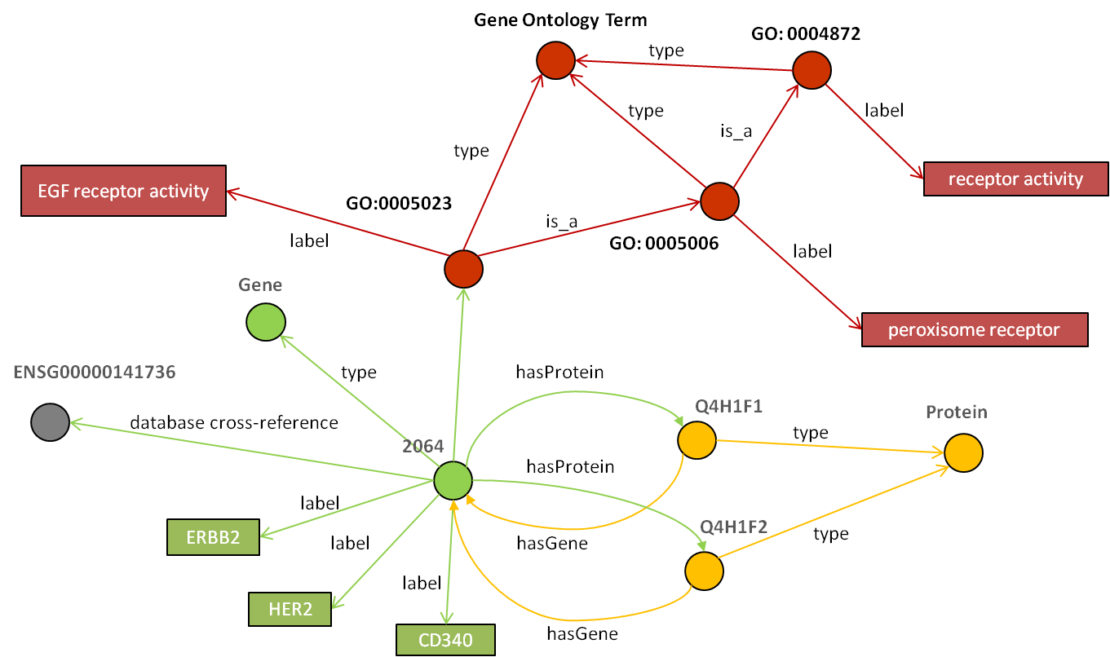



Linked Data Web Resources linked via SPO Triples
http://linkedlifedata.com
NCBI Gene

Slide 9
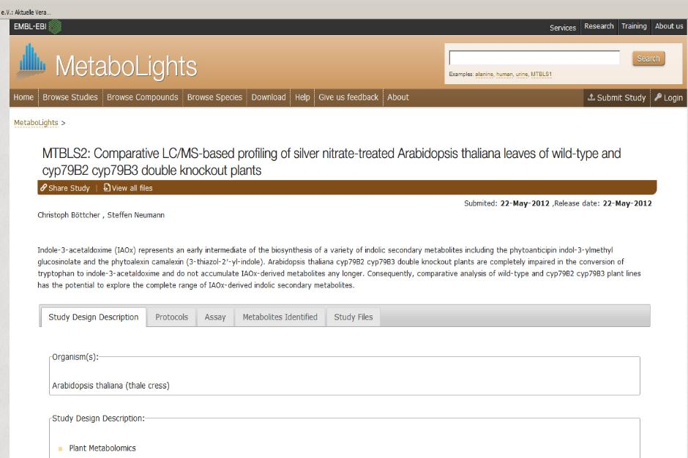



ChEBI
Gene
Taxonomy

Slide 10



Resources to link with
MS Reference Spectra
Small Molecules
Pharmaceuticals
treats
Diseases
Sample data
has_sample_source_location
GeoNames
Place Names

Slide 11

Contextual Queries
Integrative cross-resource queries
Select all MassBank records about Tryptaminergic compounds
ChEBI
Select all compounds from MetaboLights found in Brassicacae species & which were sampled in Switzerland
MetaboLights
Taxonomy
GeoNames

Slide 12
Bridging Scales & context by querying multiple LOD Resources
Added Resource
Species Resource
Gene Resource
Protein Resource
Integrative
Queries
Arabidopsis
Gene Function Resource
Gene in arabidopsis
Disease Resource
Protein coded by gene in arabidopsis
Function of Protein coded by gene in arabidopsis
Disease caused by abnormality in Function of Protein coded by gene in arabidopsis

Slide 13
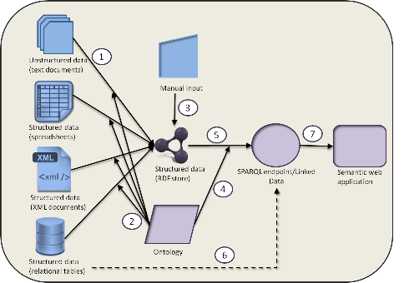
RDF as unifying Format Syntactic Integration

Slide 14
IPB triple store.N3 example SPO Triples for MassBank
@prefix rdf: <http://www.w3.org/1999/02/22-rdf-syntax-ns#> .
@prefix mbco: <http://www.ipb-halle.de/ontology/mbco#> .
peak:PB004085_129 <rdf:type> <mbco:peak> ;
peak:PB004085_129 <mbco:constituates> <mass_spectrum:PB004085> ;
peak:PB004085_129 <mbco:encodes_mz> "129" ;
peak:PB004085_129 <mbco:has_intensity> "165.326" ;
…

Slide 15

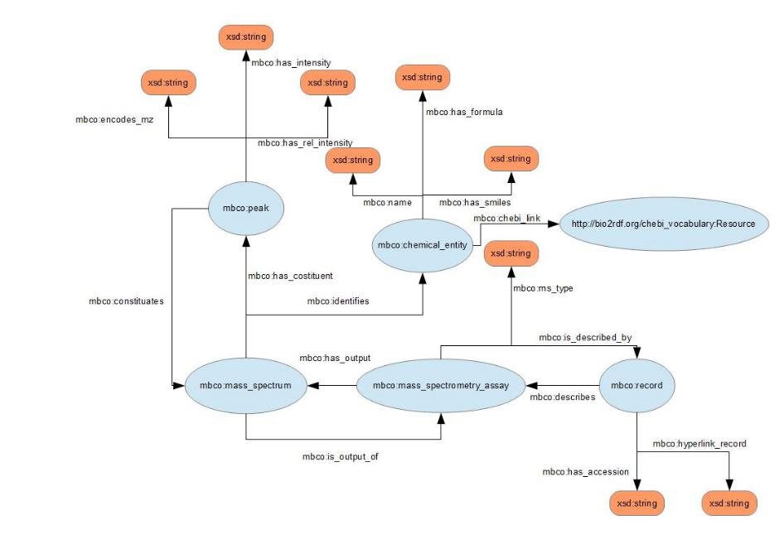
Mcbo.ttl
Mcbo.ttl
5 classes
17 predicates

Slide 16
Mcbo.ttl Mass bank core ontology
@prefix rdf: <http://www.w3.org/1999/02/22-rdf-syntax-ns#> .
@prefix rdfs: <http://www.w3.org/2000/01/rdf-schema#> .
@prefix dcterms: <http://purl.org/dc/terms/> .
@prefix mbco: <http://www.ipb-halle.de/ontology/mbco#> .
mbco:record a rdfs:Class ;
rdfs:label "record" ;
rdfs:comment "A class for massbank records" ;
rdfs:subClassOf <http://semanticscience.org/resource/SIO_000088> . # record
mbco:peak a rdfs:Class ;
rdfs:label "peak" ;
rdfs:comment "A peak of the linked spectrum" ;
rdfs:subClassOf <http://semanticscience.org/resource/SIO_011123> . # chemical data
…

Slide 17
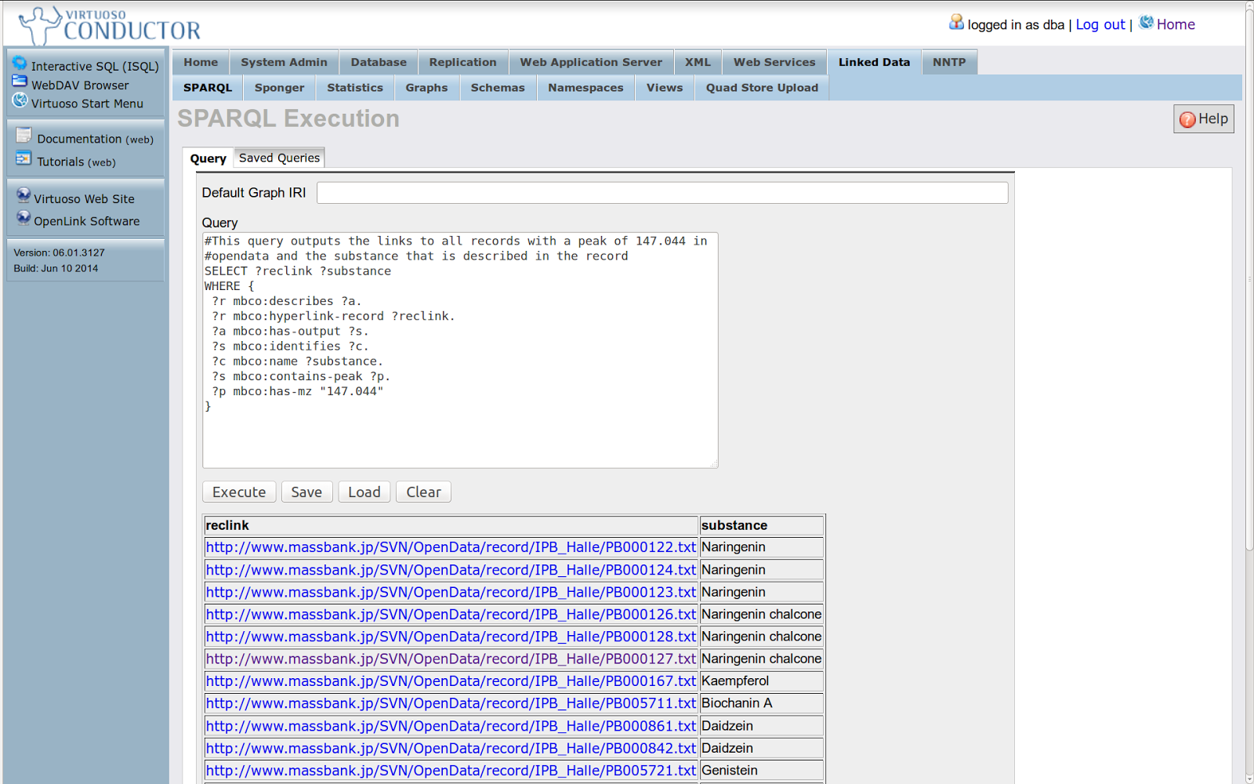
Querying Massbank
via SPARQL using Virtuoso LOD server

Slide 18
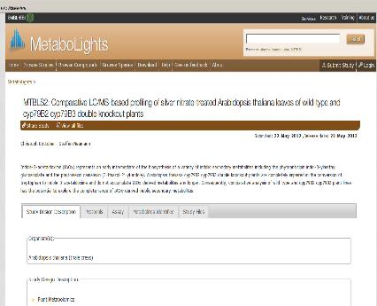
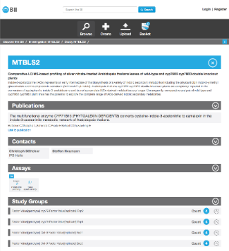
Metabolights RDF conversion (via Linked ISA)
Low granular Experiment in Metabolights
http://www.ebi.ac.uk/metabolights/MTBLS2
RDF-based highly granular Experiment in BII
http://bii.oerc.ox.ac.uk/browse/investigation/MTBLS2/study/MTBLS2/

Slide 19
Conclusion
Linked Open Data Advantages
Shareability
openly accessible via internet
Normalization
Harmonizing variant expressions to increase Query Recall
Integration
Integration across languages, dialects, schemata
via unified access mechanism
Cross resource Search, Comparison, Re-use & Re-purposing
Artificial Intelligence
Associative browsing of semantic networks
Exploit subsumption hierarchies for reasoning

Slide 20
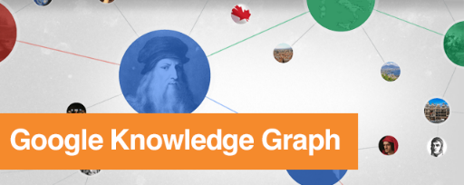
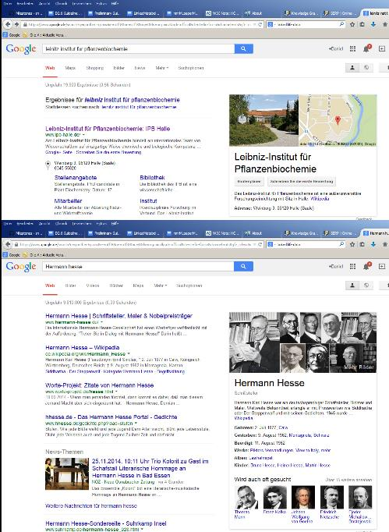
Mines Wikipedia
Merges Facts on
People, Places, Occurences into structured Search Result area

Slide 21
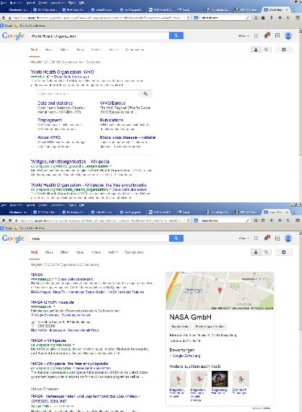
Large scale → Faulty
WHO not known ?
Wrong Company

Slide 22
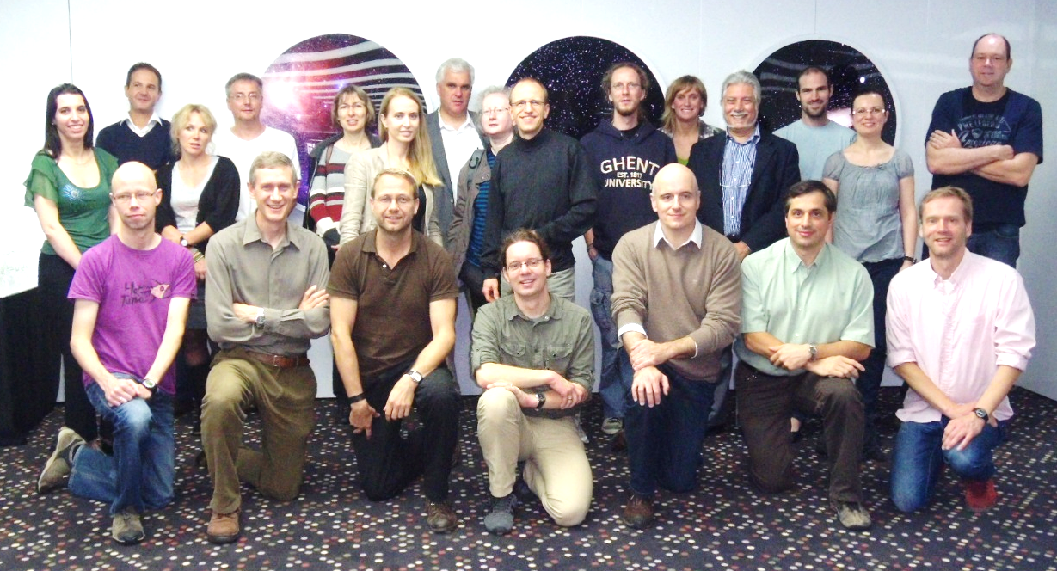
Acknowledgements
nmrML group
Reza Salek, Mike Wilson, Steffen Neumann, Christian Ludwig, Ulrich Günter, Catherine Deborde, Daniel Joseph, Antonio Rosato, John Easton, Tim Ebbels, Kenneth Haug, Annick Moing, Luis de Figueiredo, Matthias Klein, Jan Hummel, Jan Hannemann, Philippe Rocca Serra & Denis Rubtsov, Jie Hao
EU FP7 project COSMOS grant EC312941 www.cosmos-fp7.eu

